Slide 1


Macroecology and biogeography 2
How many species are there on Earth?

Slide 2
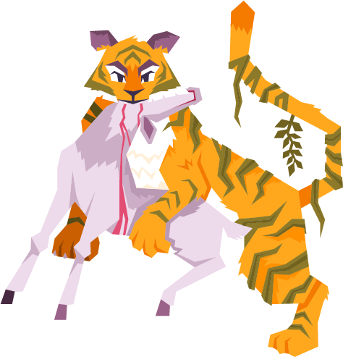

How many species?

Slide 3
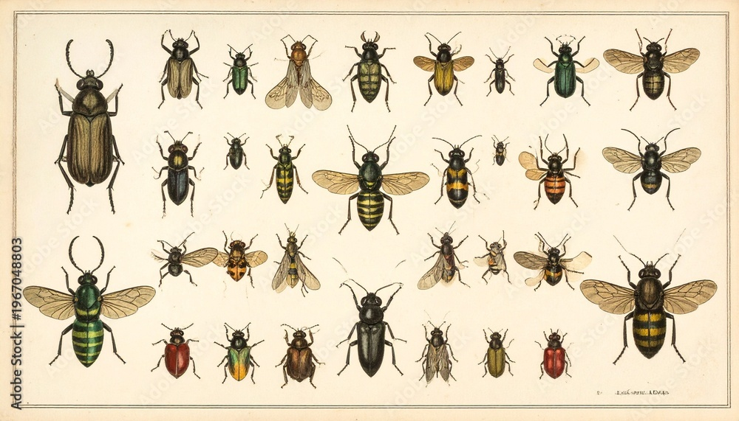
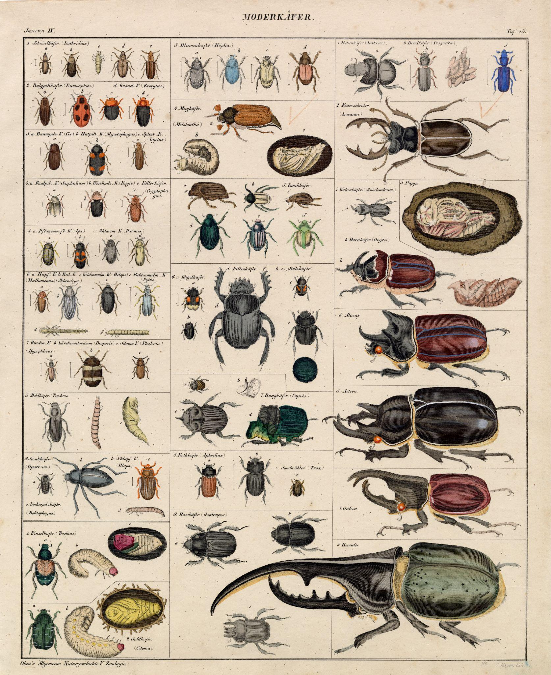
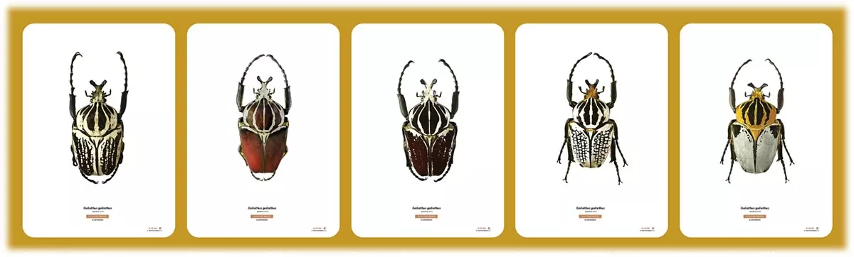
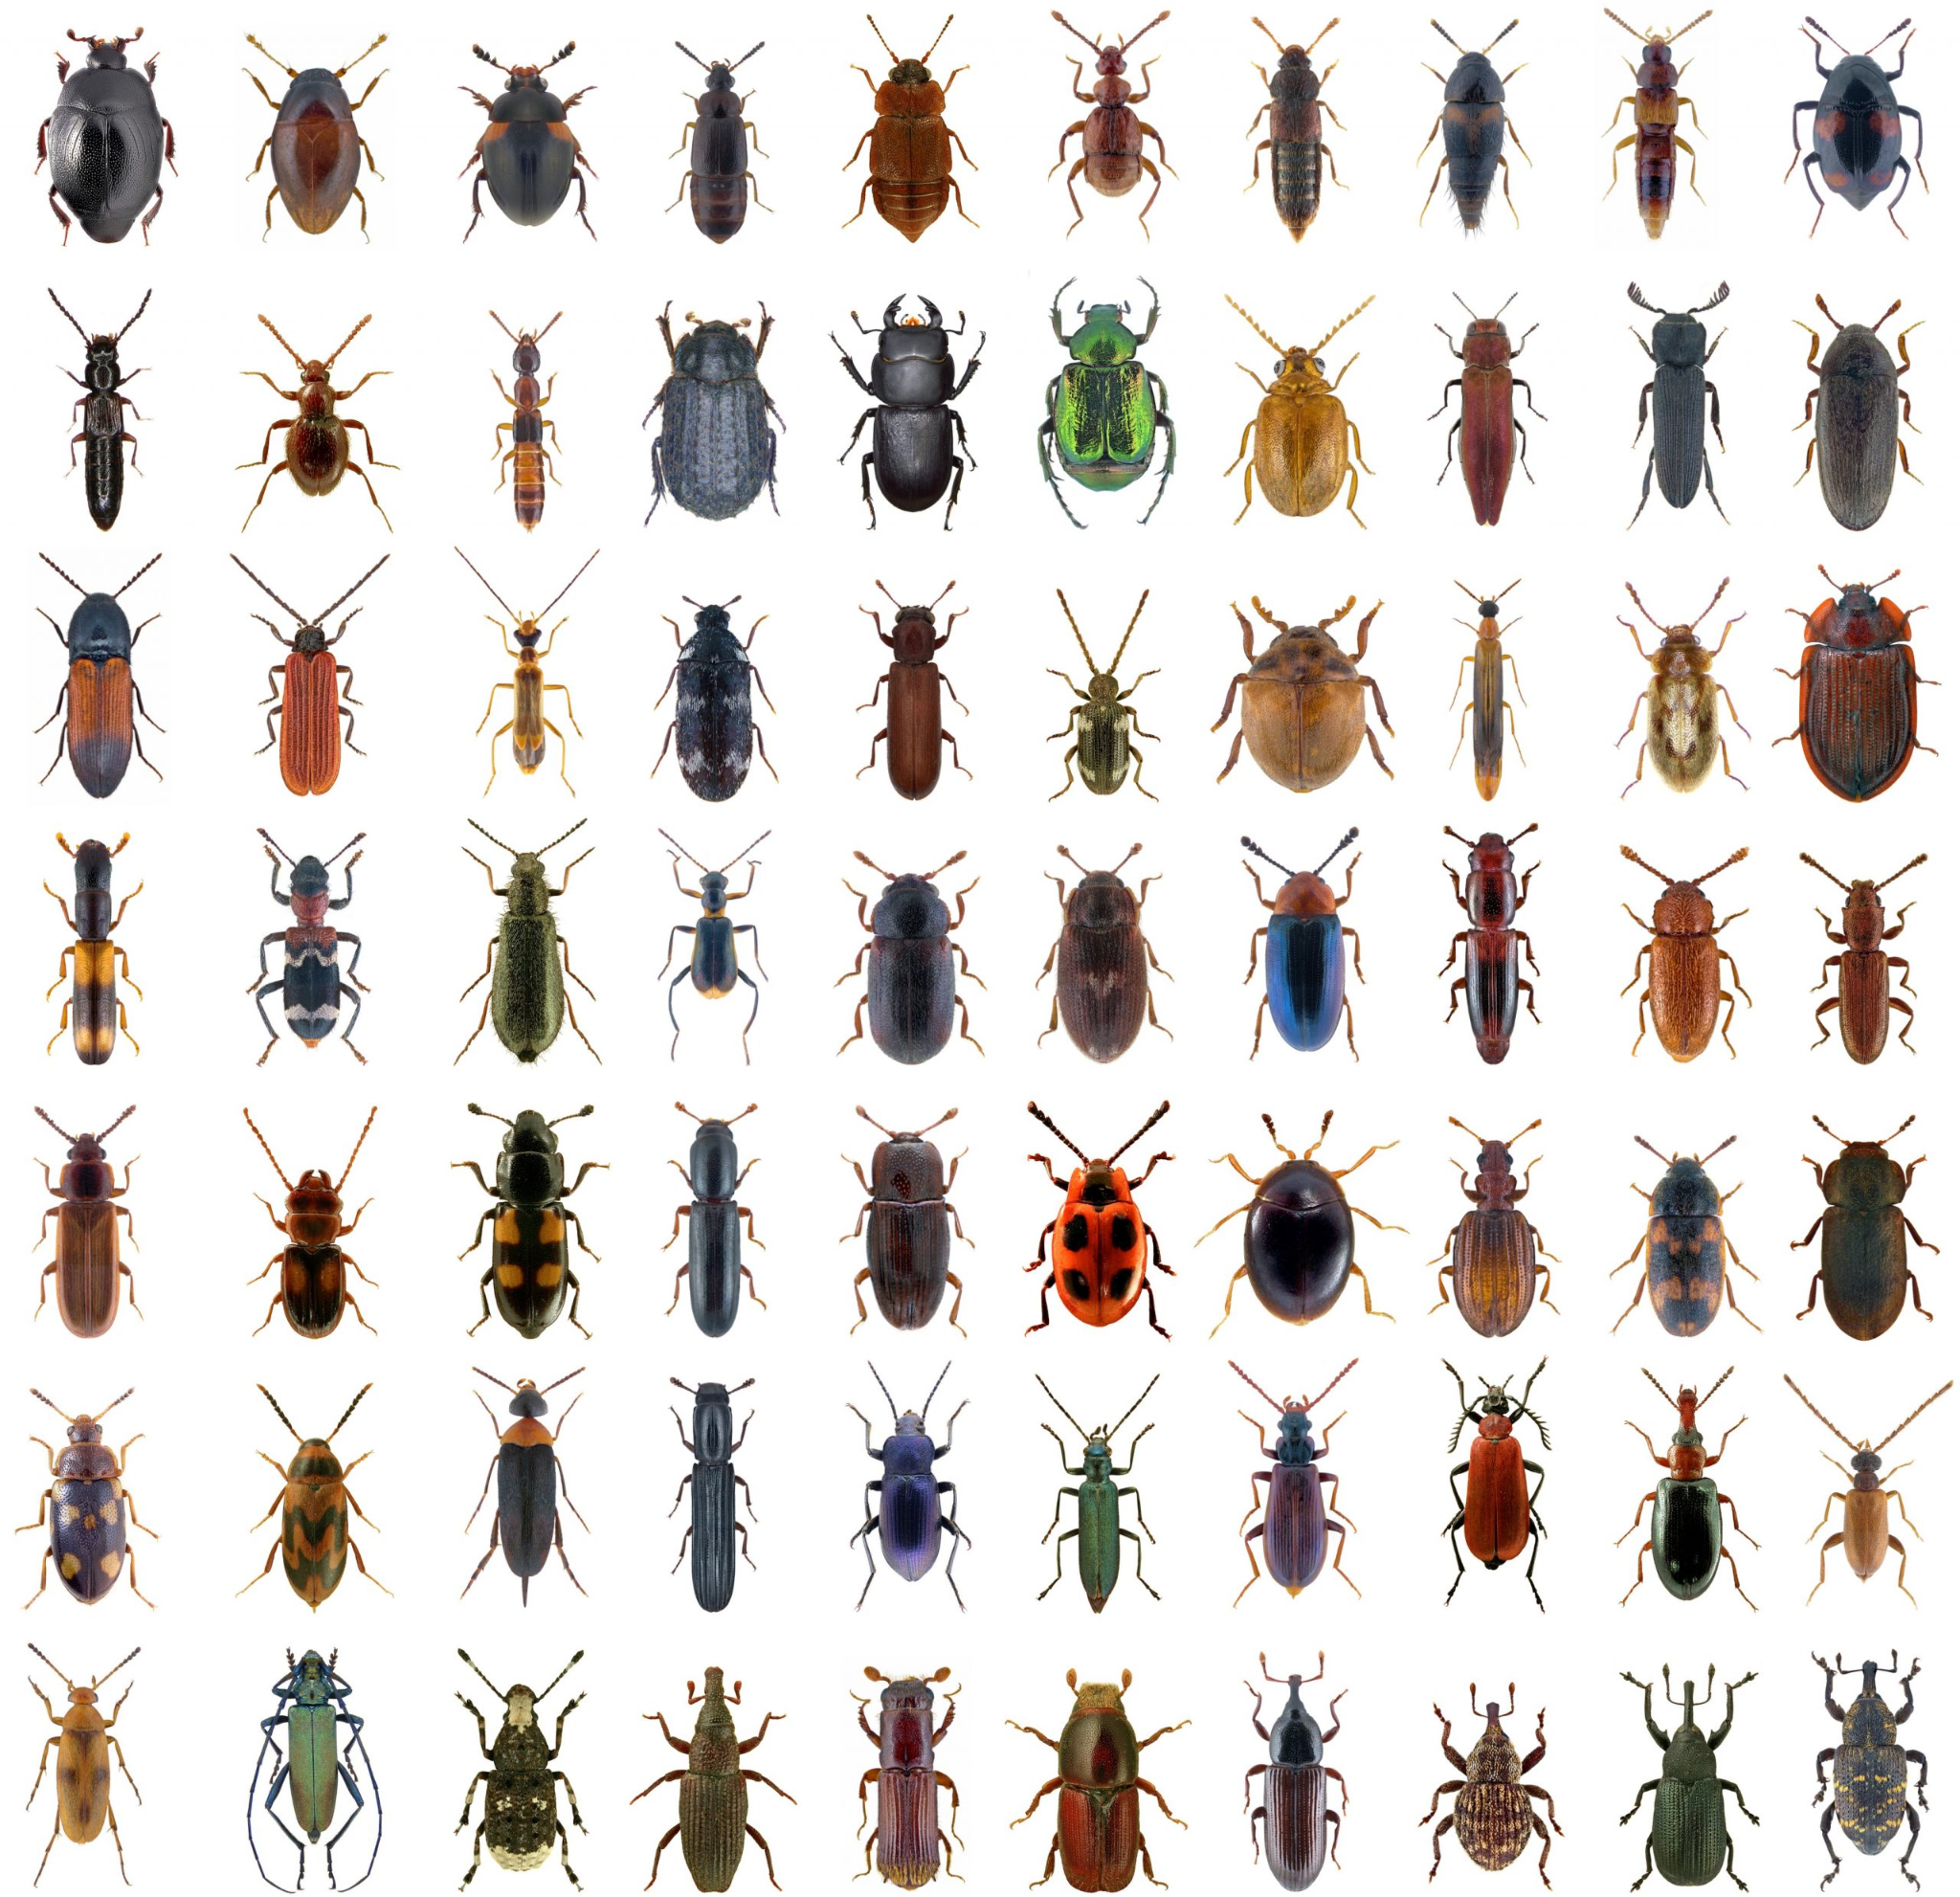
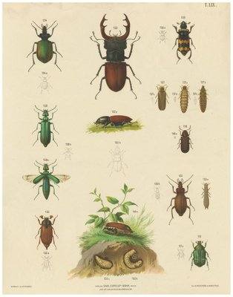
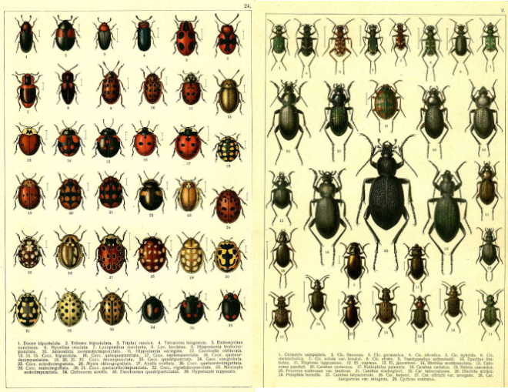
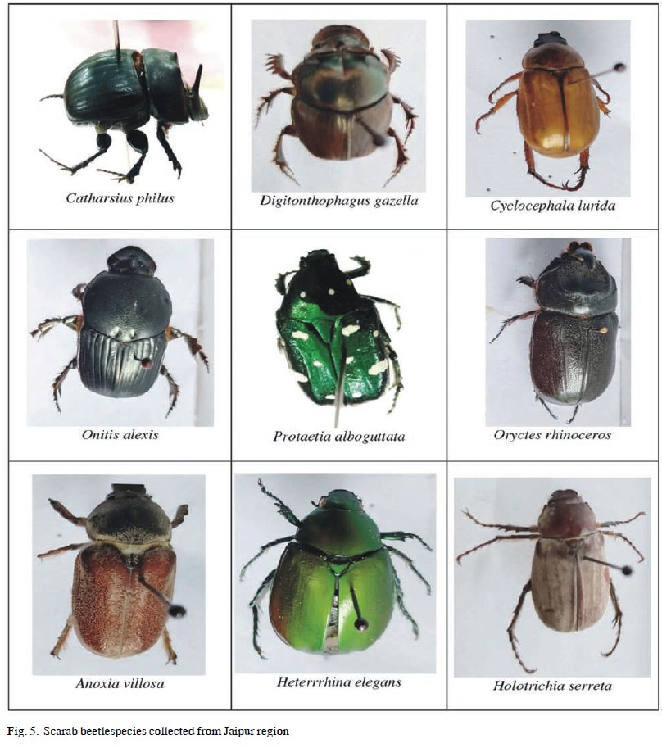
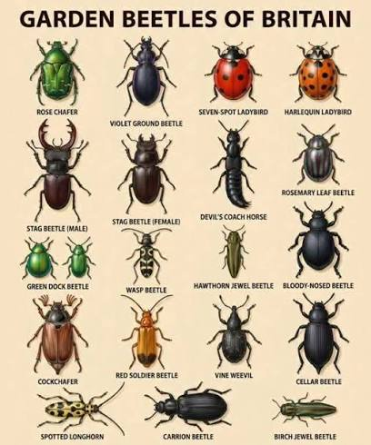
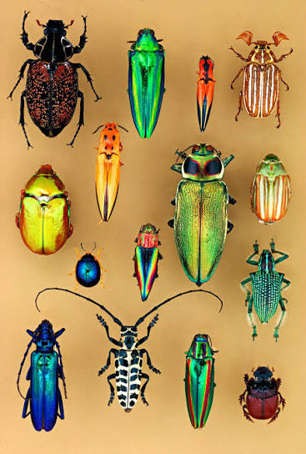
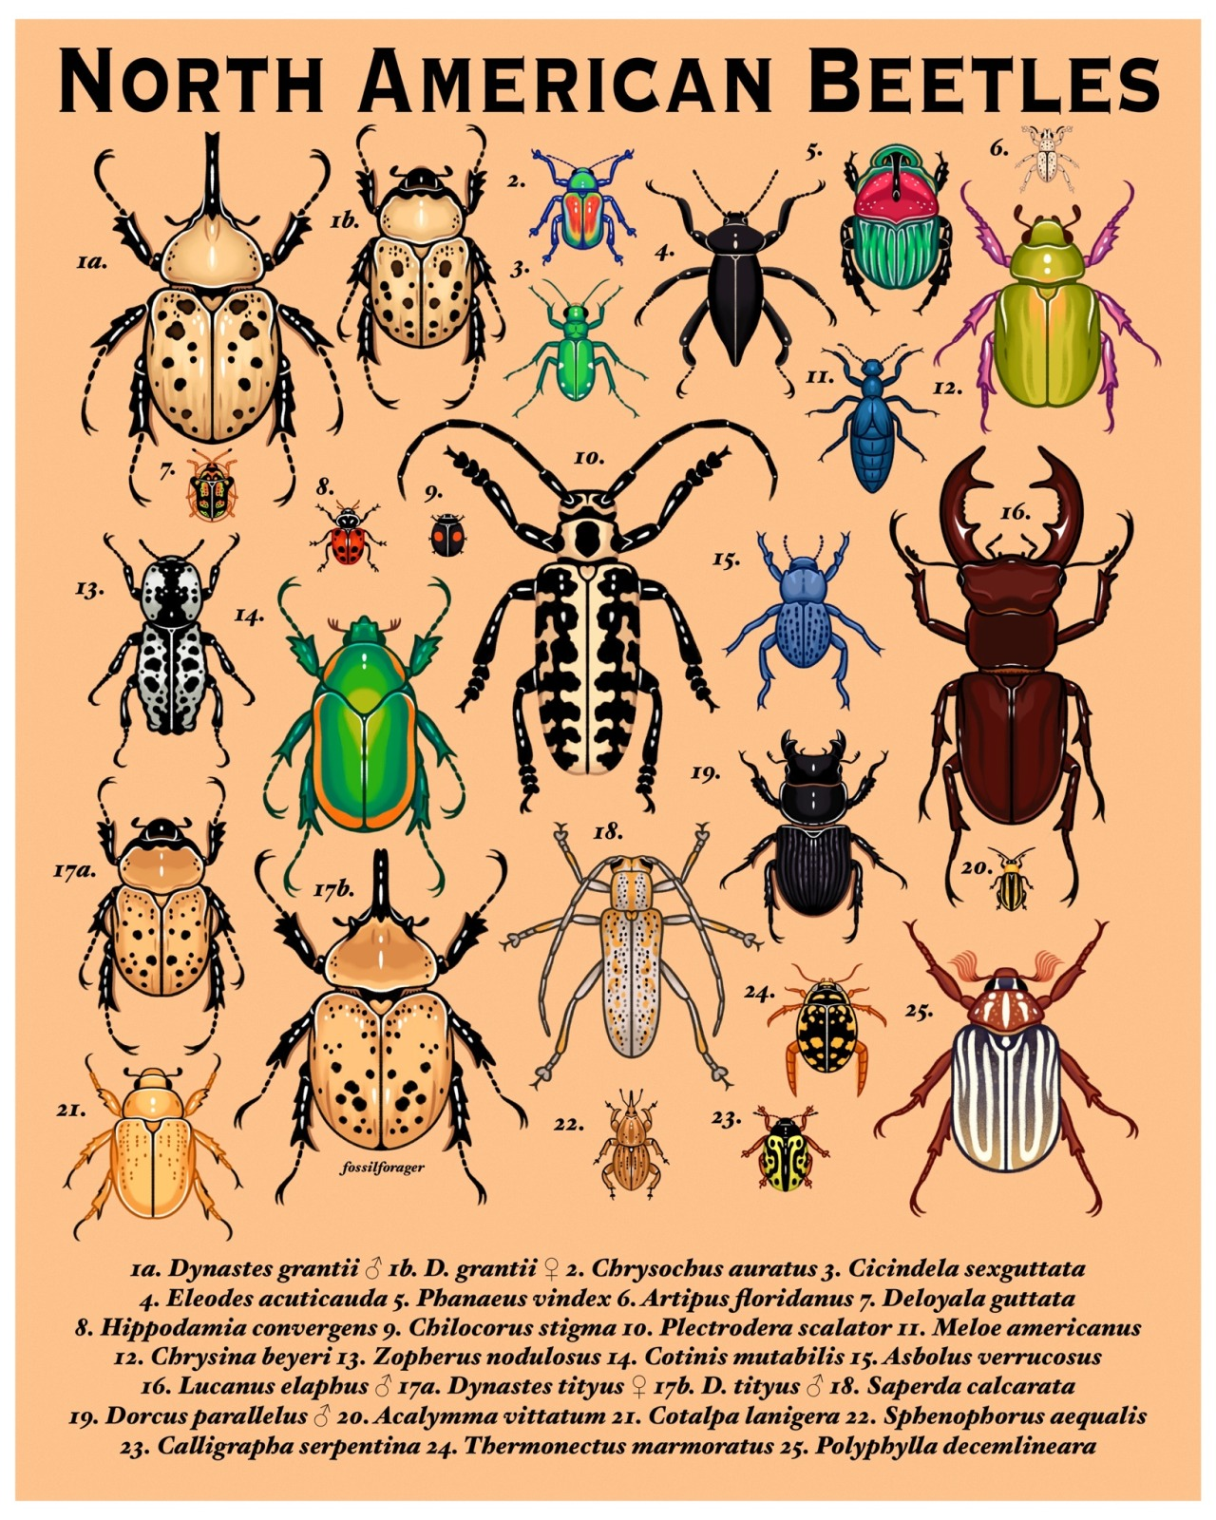
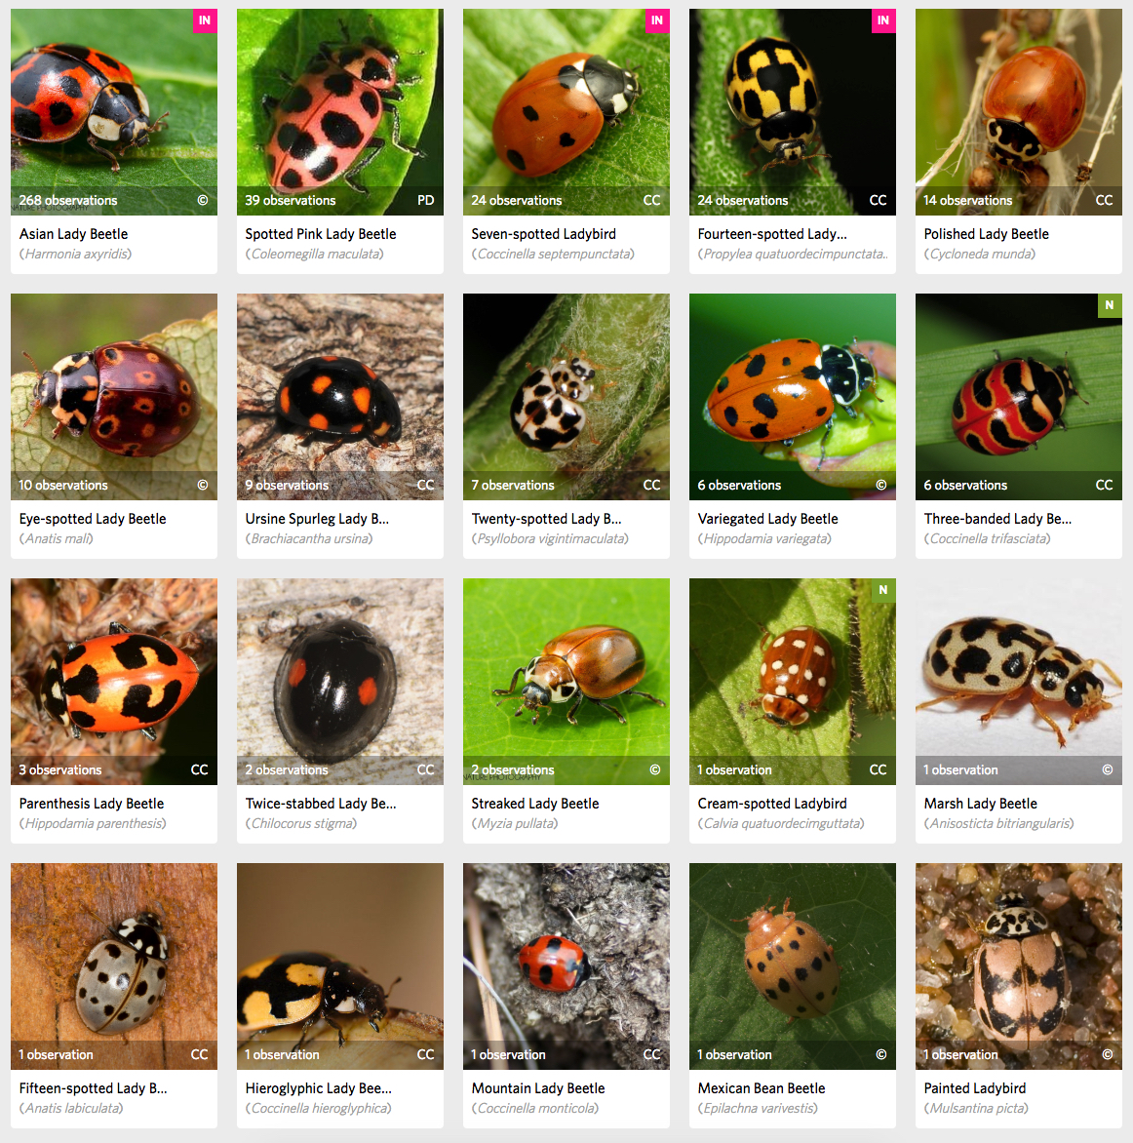

Slide 4
400 000

Slide 5
How many species?

Slide 6
Why is this question important?
-Understand population repartition
-Calculate rate of threatened species
-Watch the evolution of climate change
-Education

Slide 7
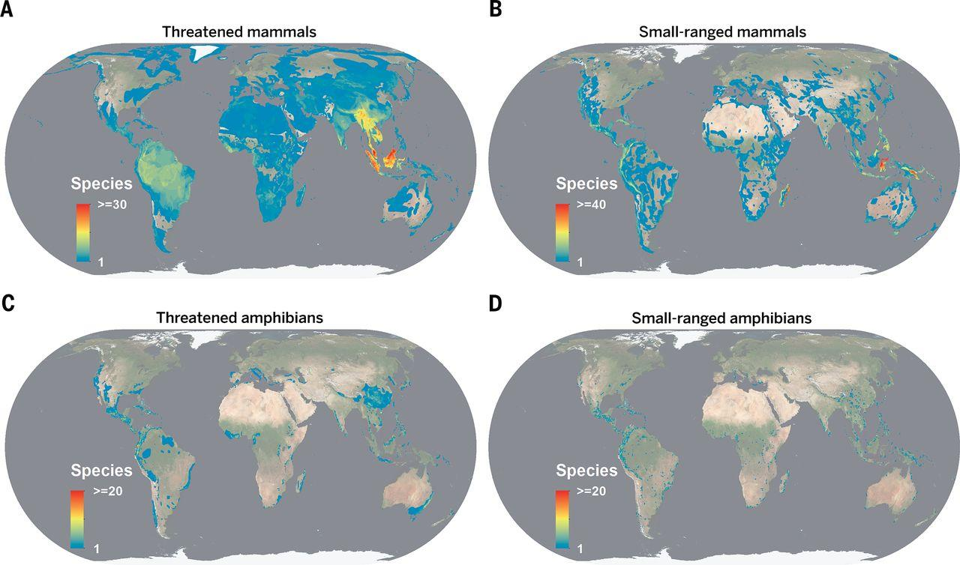
Fig.1 Repartition of small-ranged species and threatened species on different maps
Pimm, S. L., et al. (2014). The biodiversity of species and their rates of extinction, distribution, and protection.

Slide 8
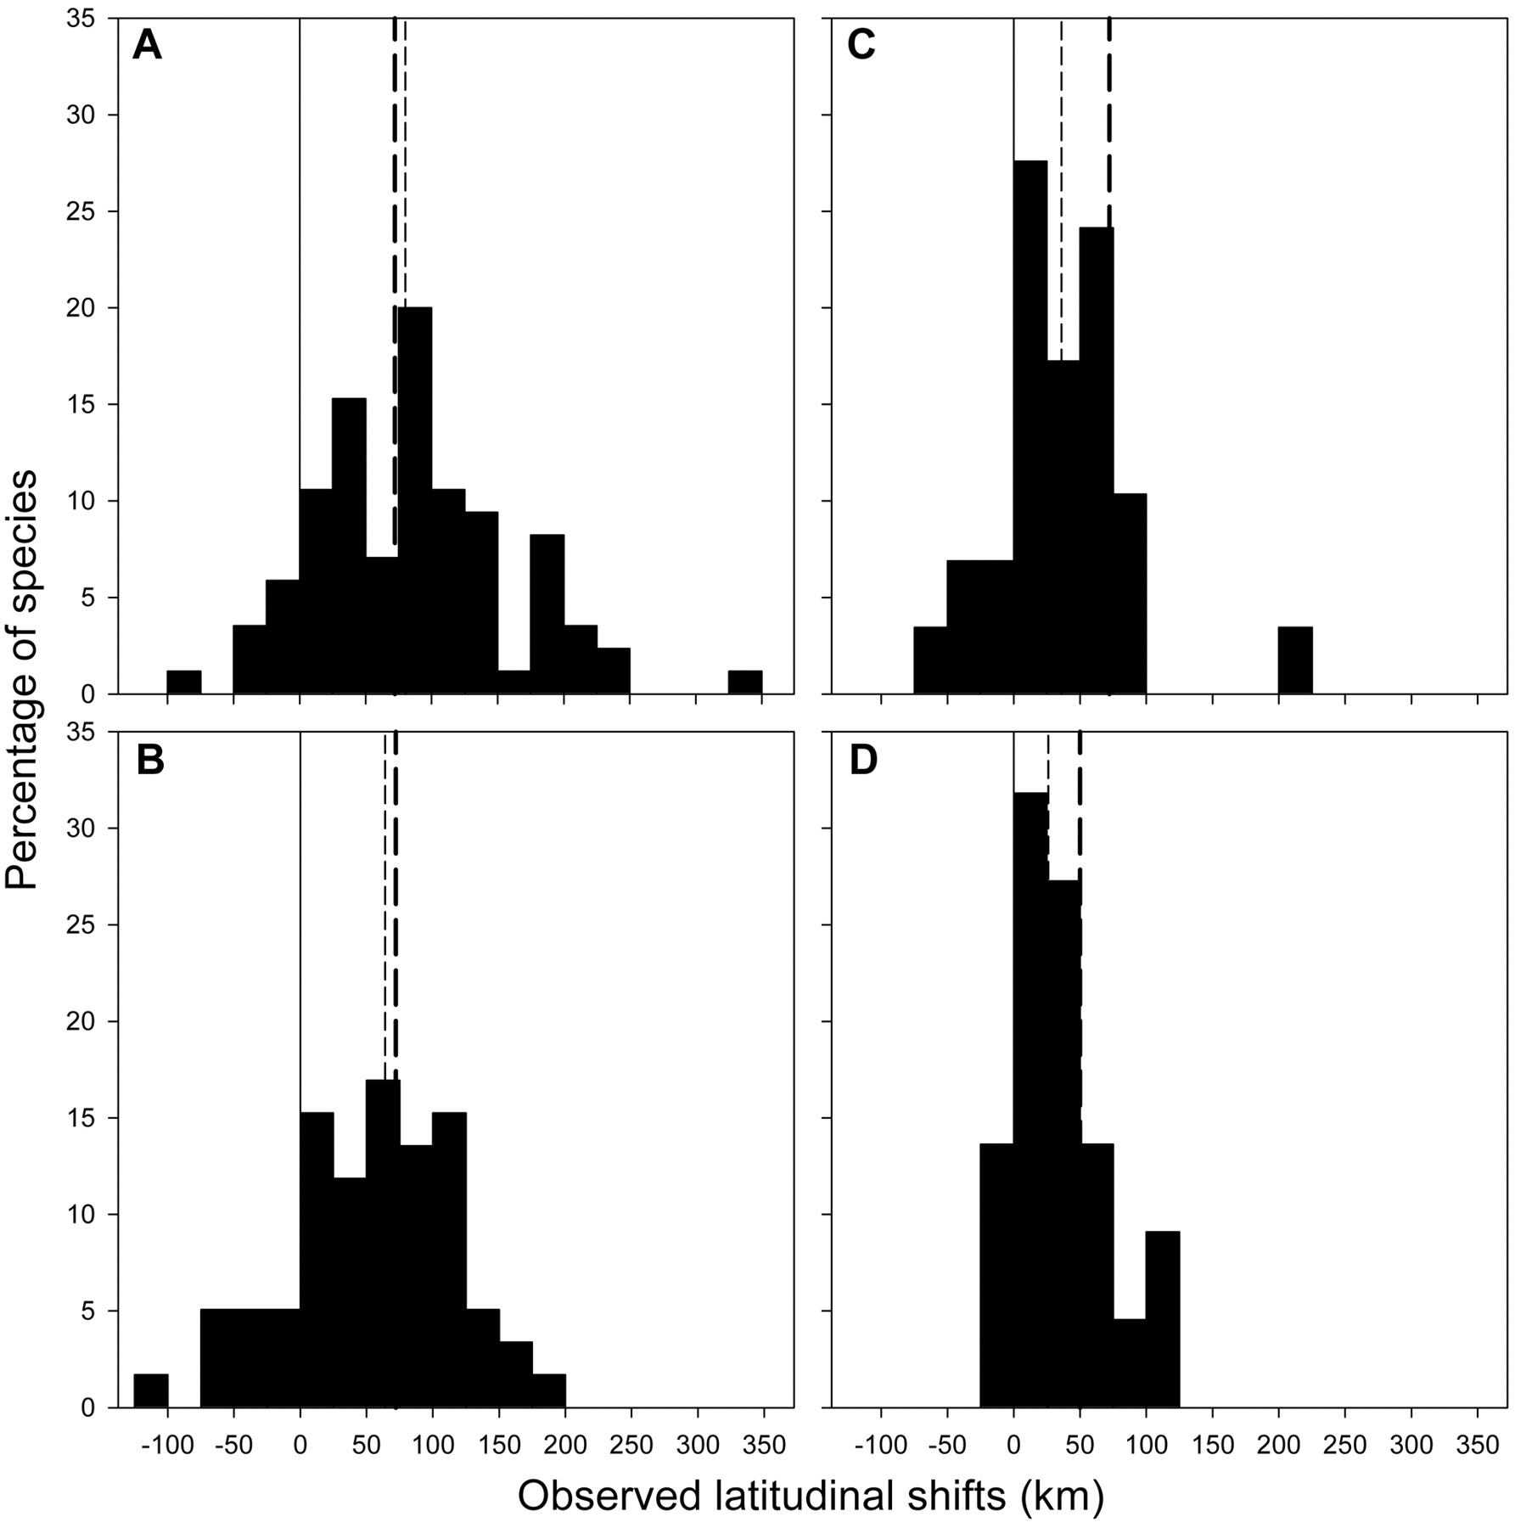
Fig.2: Observed range shift of different species
(A) Spiders (85 species),
(B) ground beetles (59 species),
(C) butterflies (29 species)
(D) grasshoppers and allies (22 species)
Chen, I.-C., et al. (2011). Rapid range shifts of species associated with high levels of climate warming.

Slide 9
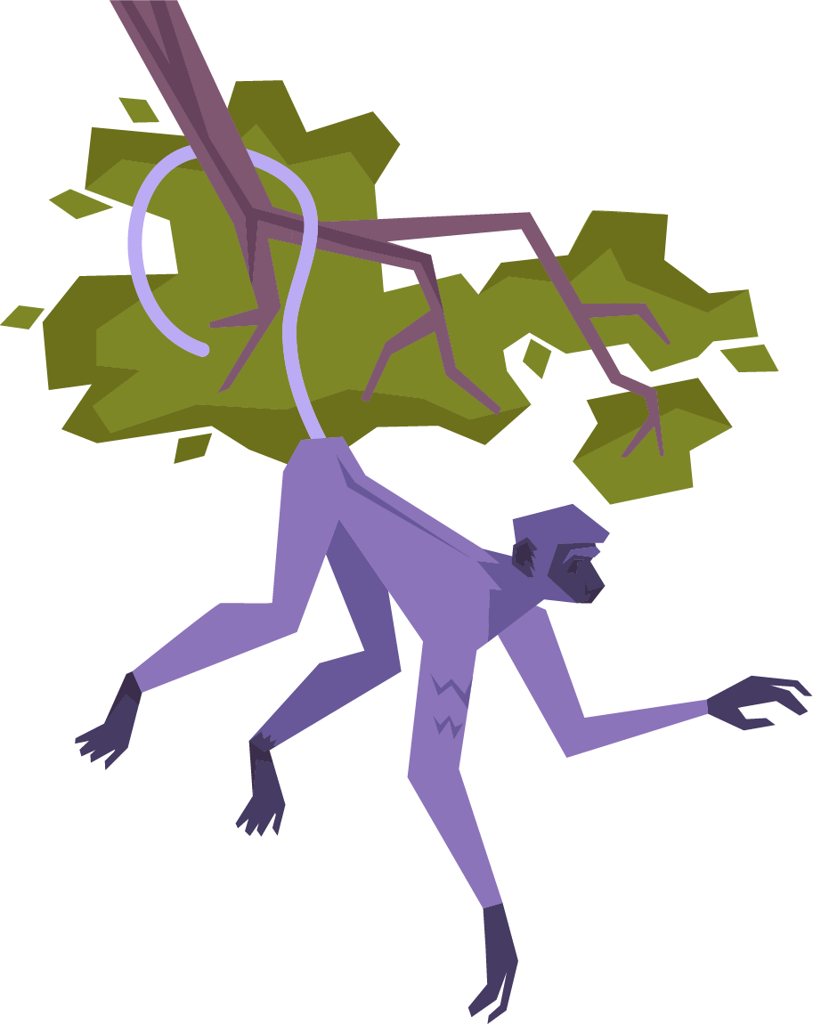
What is a specie?
Biological Species Concept (E. Mayr)
Interbreeding natural population reproductively isolated from others
G. G. Simpson. The species concept (1951).
Notes:
The question of estimating species gets even more complicated when we ask what even is a specie. One of most well known definitions which is still popular today is the biological species concept. This theory was described by Ernst Mayr and essentially says that a distinct specie is organism that is able to reproduce and their descendants are also capable of reproduction. For example mules, the child of horse and donkey, is infertile failing to meet the definition of species.

Slide 10
Limitations of BSC
Hybridization
Asexual organisms
Geographic isolation
Plants, ducks
Prokaryotes
Interbreeding in captivity
M. Grene at al. Topics in the philosophy of biology (1976).
Notes:
However, this approach has many limitations. The most important include: Exclusion of asexual organisms. Prokaryotes procreate by duplicating their central chromosome and splitting the cell, therefore not qualifying as an organism even though they are biologically very important. Another major critique is geographic isolation. Breeding organisms in captivity or laboratories doesn’t mean this would occur in nature, causing the concept to lose certainty across space. Also, there’s a process of hybridization where two different species reproduce resulting in organism with each cell having genetic material from two distinct parents. This naturally occurs mostly in plants, but was also spotted in some species of ducks.

Slide 11

Taxonomic group differences
Zoology
Bacteriology
Botany
Reproductive isolation and interbreeding barriers
Higher degree of genetic dissimilarity
Hybridization
G. G. Simpson. The species concept (1951).
Notes:
Therefore, each science tweaked the definition a bit to better fit their purpose. Zoology relies mostly on BSC, although paleontology works more with the concept of unitary lineage evolving independently on others. In botany the hybridization between recognized species is common-place. They reject the interbreeding criteria and view species as a flexible collective units that maintain clear ecological rules and morphological identities. In bacteriology prokaryotes reproduce asexually and its differentiation is even more complicated by frequent horizontal gene transfer. This species concept tolerates higher degree of genetic dissimilarity. As a consequence of these broad genetic thresholds, bacterial species encompass far broader diversity than animal or plant species.

Slide 12




Timeline
Linnaeus
Darwin
BSC
Molecular era
Species separated by distinct gaps
Avoids the mechanism of multiplication
Population
thinking
DNA and mathematical scaling
1750
1859
1950
2011
M. Grene at al. Topics in the philosophy of biology (1976).
Mora et al (2011)
Notes:
How we view the species also dramatically evolved over time and was a subject to many different interpretations and research. In the 18th century Carl Linnaeus established the concept of species as stable sharp units created in nature. He demonstrated that species in local flora and fauna are separated by distinct gaps. He effectively ended beliefs in spontaneous generations for higher organisms. Charles Darwin directly opposed Linnaeus viewing species borders as fluid, arbitrary and subjective. By eliminating this concept he avoided addressing the mechanism of species multiplication in his work. In the 1950s the Biological Species Concept took place. A species was defined as an integrated reproductive community, ecological unit, and shared gene pool. Today contemporary research incorporates environmental DNA and mathematical scaling laws to establish the boundaries of species. However, the concept continues to change based on modern technologies, progress and views.

Slide 13
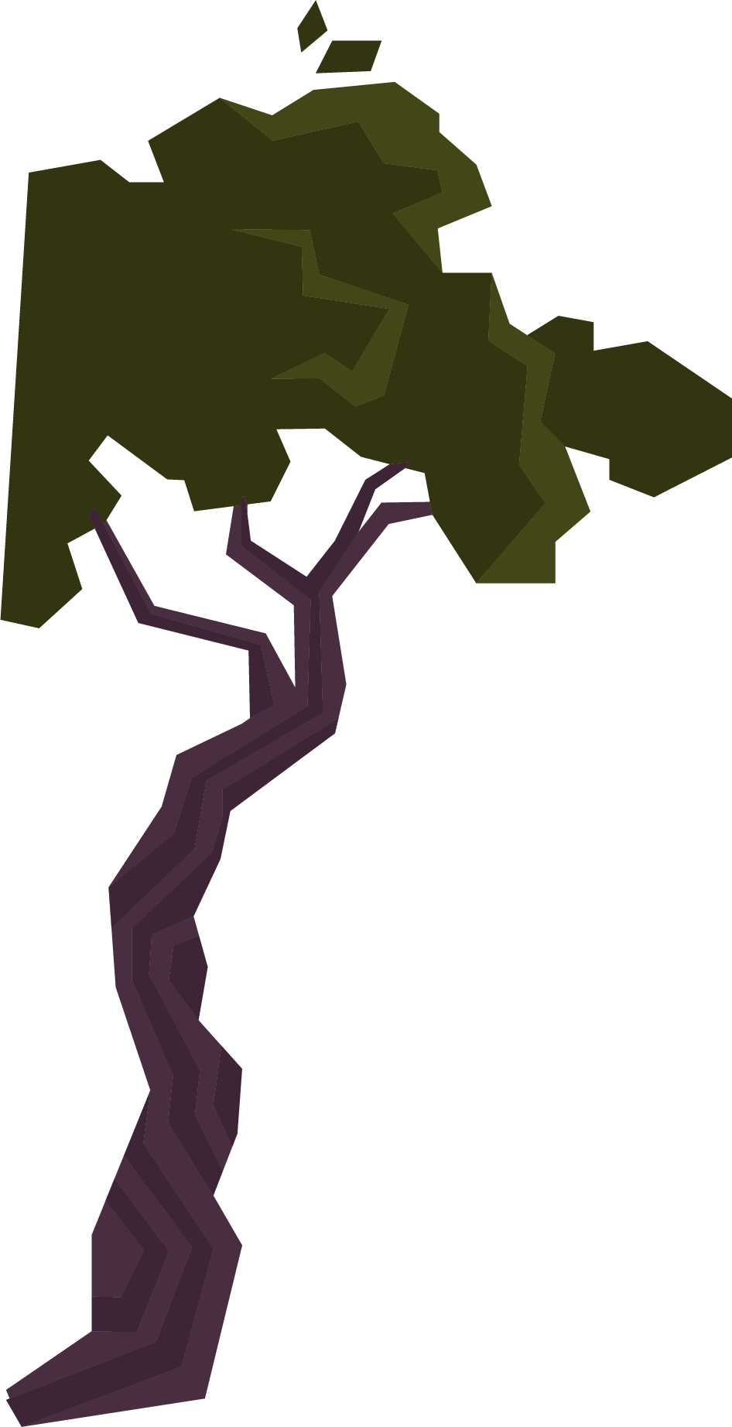


Body size frequency distribution
Case study
Limitation
Robert May concluded 10-50 million animals
-Study by Robert May
Species do not follow a universal scaling law across body size or taxa

Slide 14
Latitudinal gradient
in species
Case study
Limitation
Estimated 3 to 5 million species of large organisms.
-Study by Raven P. H.
Data is too unpredictable due to factors that affect biodiversity

Slide 15
Known to unknown ratios
Case study
Limitation
Hodkinson and Casson estimated 1.84 - 2.57 million species of insects worldwide
-Study by Hodkinson and Casson
The number of undiscovered species is difficult to estimate, and some groups are less studied than others.

Slide 16
Author-species accumulation curves
Case study
Limitation
Using the amount of descriptions it’s estimated that the species of plants yet to be discovered is 13% to 18%
- Study by Joppa L, Roberts D. L, Pimm S. L. Proc Roy Soc B
A very recent method, with assumptions about the use of molecular techniques and the fact that some co-authors are not taxonomic experts.

Slide 17
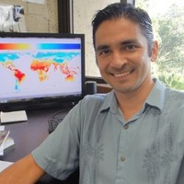

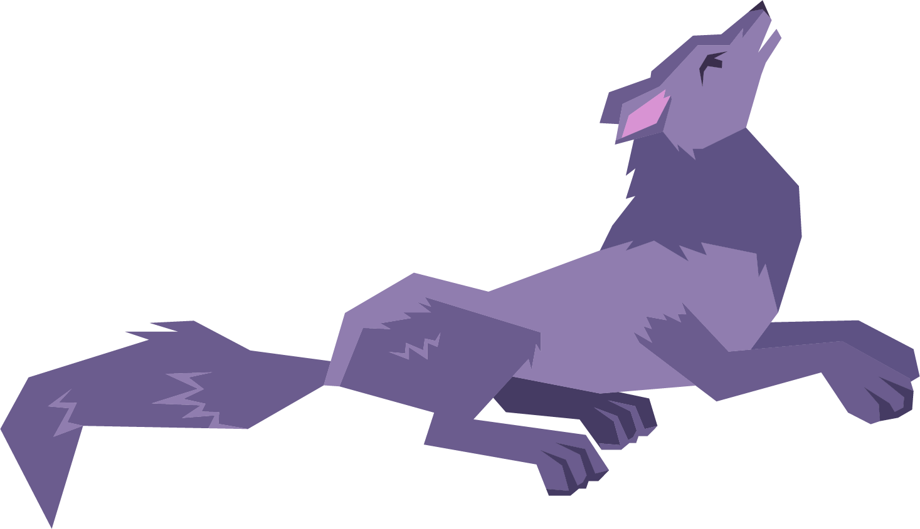


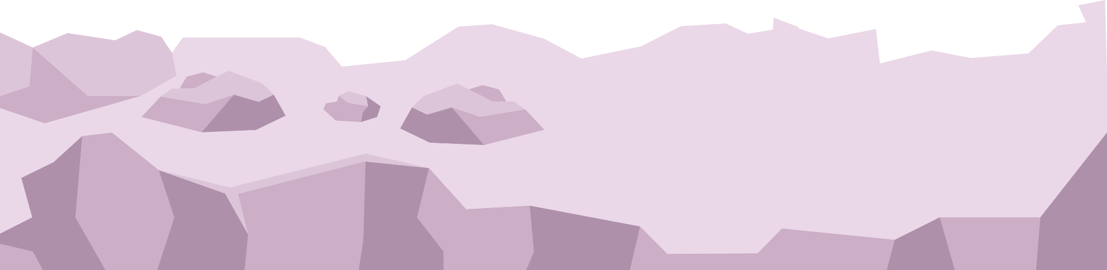
01
Macroecology
Estimation/extrapolation
02
The study of ecological patterns in a global scale
Camilo Mora

Slide 18
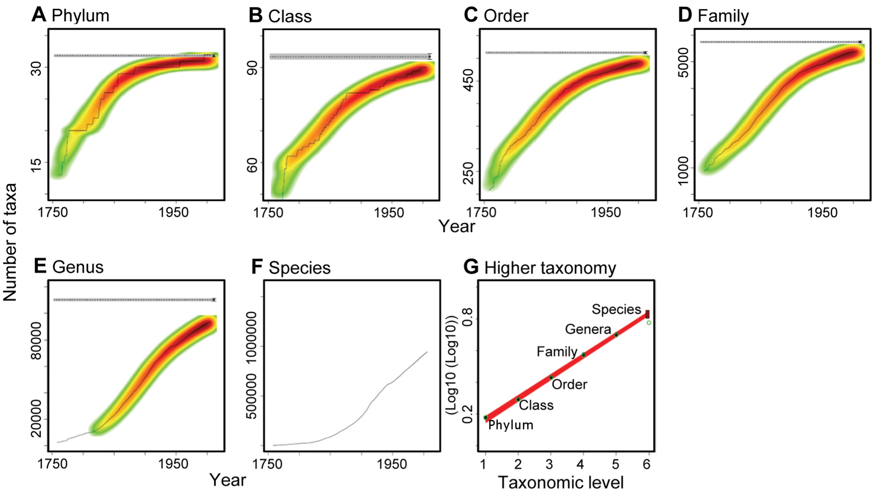
Mora’s Graphics - stagnant higher taxa
2011
Stagnant higher taxa
Mathematical relation - regression
Extrapolation
https://journals.plos.org/plosbiology/article?id=10.1371/journal.pbio.1001127#s4
2011

Slide 19

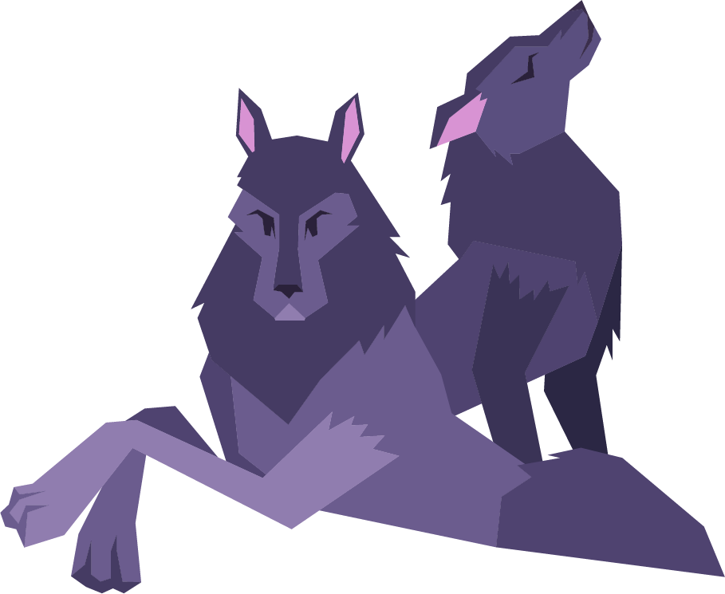
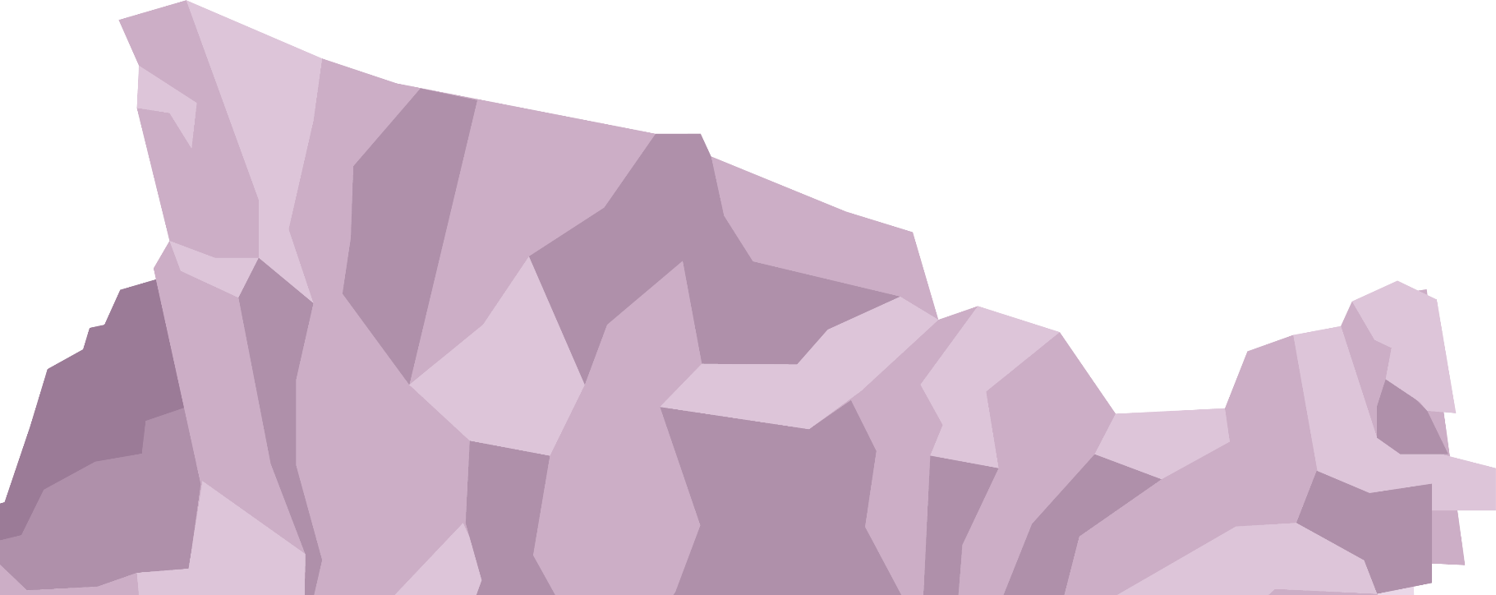

8,75 million

Slide 20
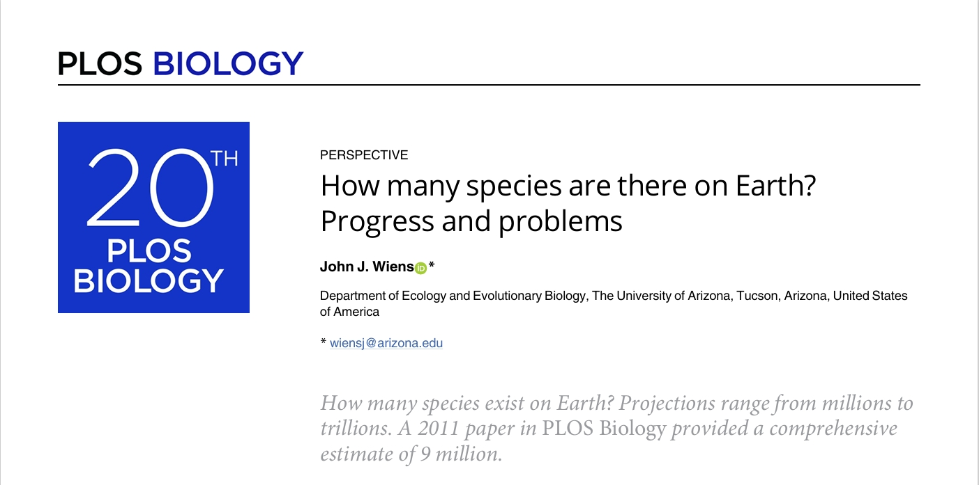
Wiens JJ (2023) How many species are there on Earth? Progress and problems. PLoS Biol 21(11): e3002388. https://doi.org/10.1371/journal. pbio.3002388

Slide 21
Why is it so hard to estimate the total number of species?
01
01
05
02
06
Limited DNA data
Underestimation of prokaryotic diversity
Cryptic Diversity
Assumption of stagnation
John J. Wiens in How many species are there on Earth? Progress and problems

Slide 22



Limited DNA data
The introduction of molecular techniques, like metabarcoding and DNA sequencing, revealed a biodiversity far greater than previously recognized.
John J. Wiens in How many species are there on Earth? Progress and problems

Slide 23
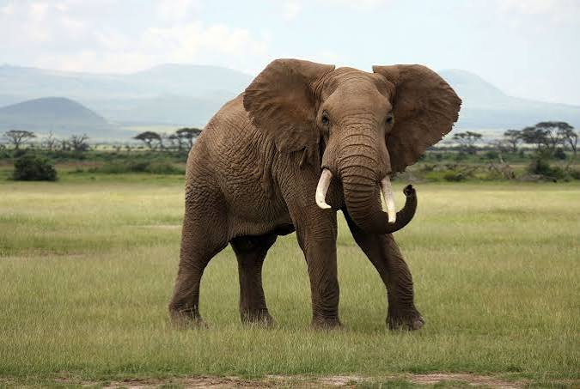
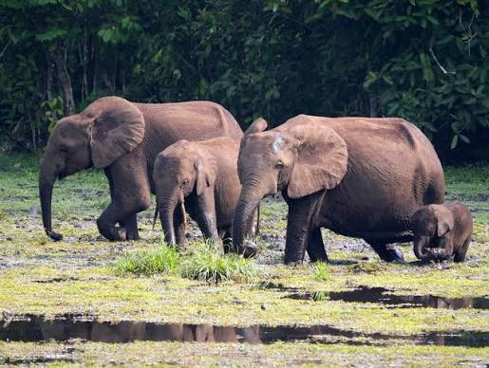
Cryptic Diversity
Loxodonta africana
Loxodonta cyclotis
John J. Wiens in How many species are there on Earth? Progress and problems

Slide 24
Prokaryotic Diversity
“Prokaryotes may be a major driver of Earth’s overall species richness.”
John J. Wiens in How many species are there on Earth? Progress and problems
Massively underestimates the true scale of global biodiversity
2.2 – 4.3 Million OTUs
Currently
OTUs - Operational Taxonomic Units

Slide 25
Assumption of Stagnation
“Overall we suggest that the known Tree of Life is continuing to rapidly expand with many newly discovered clades”
John J. Wiens in Global biodiversity and the expanding Tree of Life
“We found that >700 new genera are described each year, along with new families and orders, all based on newly discovered species. New genera are dominated by animals, whereas new families, orders, and classes are dominated by microscopic organisms. “

Slide 26
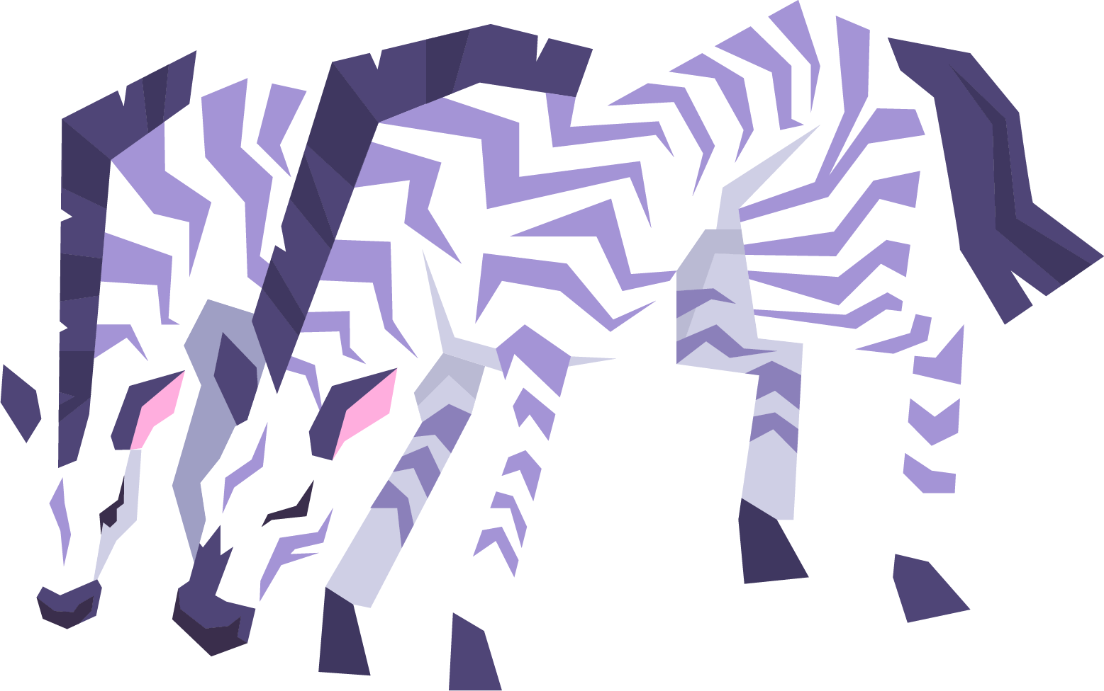
Conclusion
To actually estimate the number of species, we need:
Investments in DNA sequencing
Research in neglected habitats
$364 billion
303k full-time taxonomists
Mora at al. 2011

Slide 27

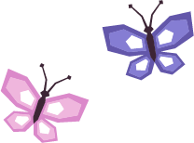




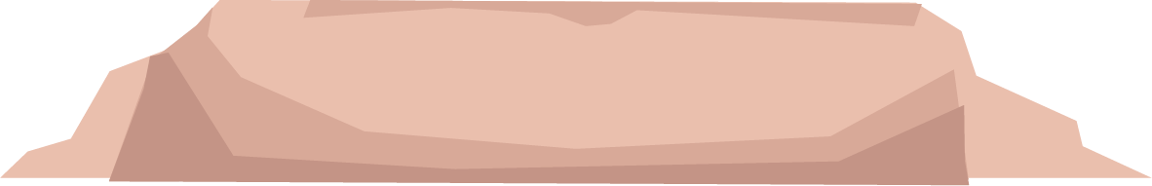
—John J. Wiens
“Soon we may not be estimating how many species there are on Earth. We will be estimating how many there were.”

Slide 28



Our group
Klára Plívová
Stan Tsvetkov
Elise Tassel
Species definitions and conclusion
Analysis of Scientific Methods
Reasons to calculate the number of species

Slide 29


Our group
Daniela Duarte
Inês Santos
Mora’s scientific article;
Limitations to species counting methods
Limitations to species counting methods

Slide 30
Resources
Study material:
https://docs.google.com/document/d/1qpB0loHDO-265KJWud_EQlgqcp3MbAXueFxQ2m2JX28/edit?tab=t.0
Photos:
https://centurylibrary.com/shop/animals/insects-beetles-vintage-okens-naturgeschichte-artwork-1830s/
https://tinyurl.com/yknbhjk6 https://tinyurl.com/43rnnm5m https://tinyurl.com/2s3ema85 https://tinyurl.com/4xz65nbu
https://tinyurl.com/4cf54u44 https://tinyurl.com/ykfspatk https://tinyurl.com/yt7jems2 https://tinyurl.com/43p8d6hw
https://tinyurl.com/424sc6a6 https://tinyurl.com/242rm8xe
Sources:
https://www.jstor.org/stable/2405675
https://www.cell.com/trends/ecology-evolution/fulltext/0169-5347(95)90031-4
https://link.springer.com/chapter/10.1007/978-94-010-1829-6_16
https://pubmed.ncbi.nlm.nih.gov/15253349/

Slide 31
Wiens JJ (2023) How many species are there on Earth? Progress and problems. PLoS Biol 21(11): e3002388. https://doi.org/10.1371/journal. Pbio.3002388
Mora C, Tittensor DP, Adl S, Simpson AGB, Worm B (2011) How Many Species Are There on Earth and in the Ocean? PLoS Biol 9(8): e1001127. doi:10.1371/journal.pbio.1001127
Grene M, Mendelsohn E, eds (1976) Topics in the Philosophy of Biology. Boston Studies in the Philosophy of Science, vol 27\. D. Reidel Publishing Company, Dordrecht. doi:10.1007/978-94-010-1449-6
Simpson GG (1951) The Species Concept. Evolution 5(4): 285–298\. doi:10.2307/2405675
May R. M. How many species are there on earth? Science. 1988;241:1441–1449. doi: 10.1126/science.241.4872.1441.
Raven P. H. Disappearing species: a global tragedy. Futurist. 1985;19:8–14.
Hodkinson I. D, Casson D. A lesser predilection for bugs: Hemiptera (Insecta) diversity in tropical forests. Biol J Linn Soc. 1991;43:101–119.
Joppa L, Roberts D. L, Pimm S. L. Proc Roy Soc B; 2010. How many species of flowering plants are there? doi: 10.1098/rspb.2010.1004

